Slide 1
CS2040 Lab #01
Join Telegram group: https://t.me/joinchat/OA81xhyqwnRsgvan_wcScg

Slide 2

Self-introduction
Gao Haochun (e0376955@u.nus.edu)
Year 2, Business Analytics
Double major in Statistics
Learning Japanese
Playing badminton

Slide 3
Overview
Some information about lab
Codecrunch and Grading criteria for lab
Go through Lab 0
Discuss Lab 1
Discuss Unix and Vim command

Slide 4
Some information about lab
No participation mark for lab
Three questions every week. Code for second question needs to be submitted one day after lab session
Demo the third question during the lab
Advice: write your lab via Sunfire because PE will be conducted in Unix system. You’d better get familiar with vim and Unix system.
Ground rule: No plagiarism. Sharing of ideas is allowed, but please don’t show your codes to your classmates.

Slide 5
Codecrunch and Grading criteria for lab
Consist of two parts: algorithm and program design
Algorithm: pass all the test cases in codecrunch
Style and design: comments, indentation, identifier, etc.
General comments: should be meaningful, brief comment on complex parts of the code
Avoid line-by-line translation of code to English
Avoid long paragraph for the purpose of making comments more apparent
Avoid comments to fix poor naming / coding style (fix the coding style in the first place)

Slide 6
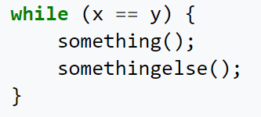
Codecrunch and Grading criteria for lab
For indentation: consistent with what you have learnt in CS2030
More examples will be shown in demo
Notes:
First thing that popped into my mind when i read question

Slide 7
Lab 0

Slide 8
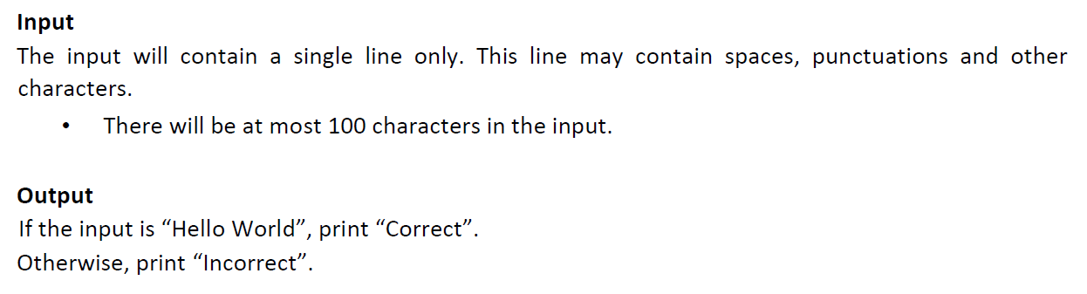
Lab 0 Q1 Hello World
Use equals() method to check whether two strings are identical
For reference type, “==” only checks whether the address of two objects are the same.
Notes:
First thing that popped into my mind when i read question

Slide 9
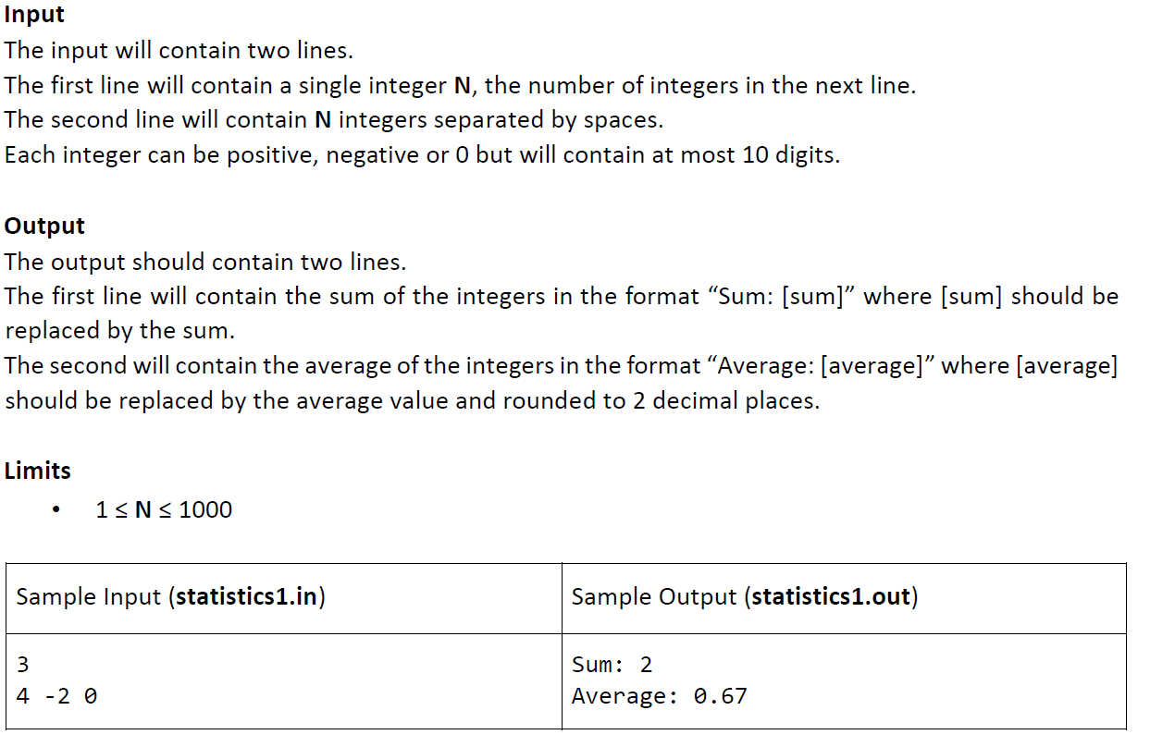
Lab 0 Q2 Statistics
Notes:
First thing that popped into my mind when i read question

Slide 10
Lab 0 Q2 Statistics
Range of int/Integer in java is -2147483648 to 2147483647 so you need scanner.nextLong() to read in the numbers and use long type to store the number
To output a number with 2 decimal places:
String.format("The floating number is %.2f", NUMBER);
Notes:
First thing that popped into my mind when i read question

Slide 11
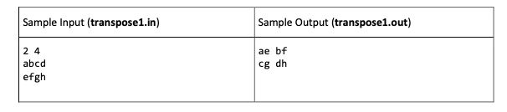
Lab 0 Q3 Transpose
Pseudocode:
Get the inputs rows and columns
Create initial matrix of int[rows][columns] ➔ myMatrix
Nested for loop to establish myMatrix values
For(i = 0 to rows exclusive)
For(j = 0 to columns exclusive)
myMatrix[i][j] = nextInput
4) Create transposed matrix of int[column][row] ➔ transpose
5) For(i = 0 to rows exclusive)
For(j = 0 to columns exclusive)
transpose[j][i] = myMatrix[i][j]
6) Use a nested for loop to print out each row in the transposed matrix

Slide 12
Lab 01
Solutions to Question 1 & 2 will be provided in next lab.
This week we only discuss the basic ideas for Question 1 & 2.

Slide 13
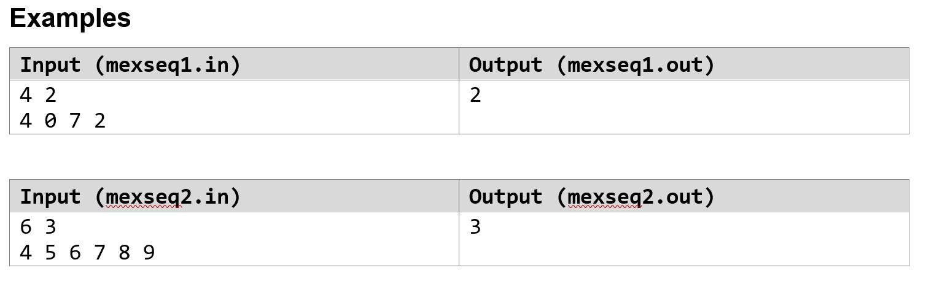
Qn1. Uncle Grandpa and MEX
MEX: The MEX of a sequence is the minimum non-negative integer that doesn’t appear in the sequence.
For example, the MEX of the sequence [0 5 2 1] is 3 , and the MEX of the sequence [1 1 2 3 4] is 0.
“Good”: the MEX of this sequence is exactly x.
Make a sequence “good” in the minimum number of operations (addition/removal)
Notes:
Very simplified

Slide 14
Qn1. Uncle Grandpa and MEX
Basic ideas: to make x the MEX of a sequence, for 0 to x-1, if the number is not in the sequence, add it; then remove all the x in the sequence
Hint: use an array of size 501, array[i] indicates the times the number i appear in the sequence.
Notes:
Very simplified

Slide 15
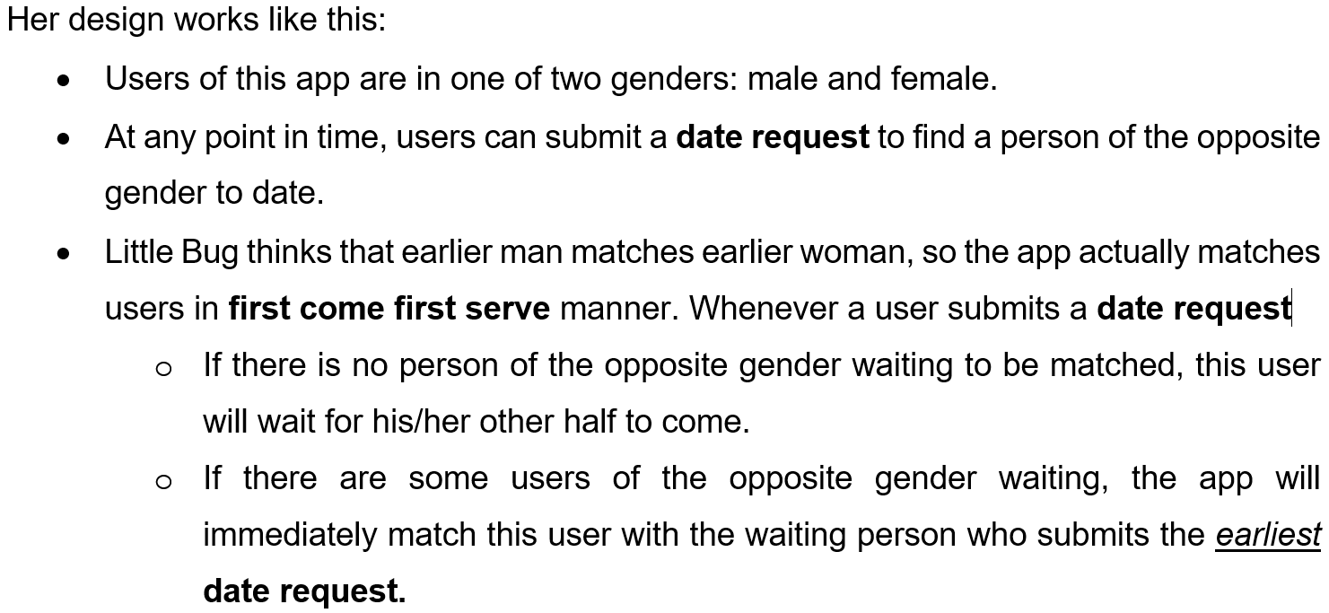
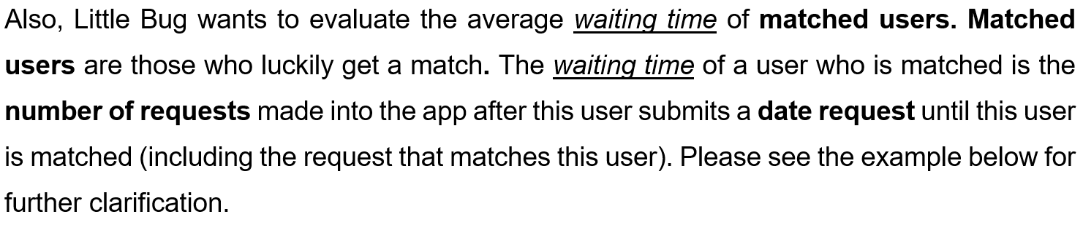
Qn2. New dating app
Notes:
Very simplified

Slide 16
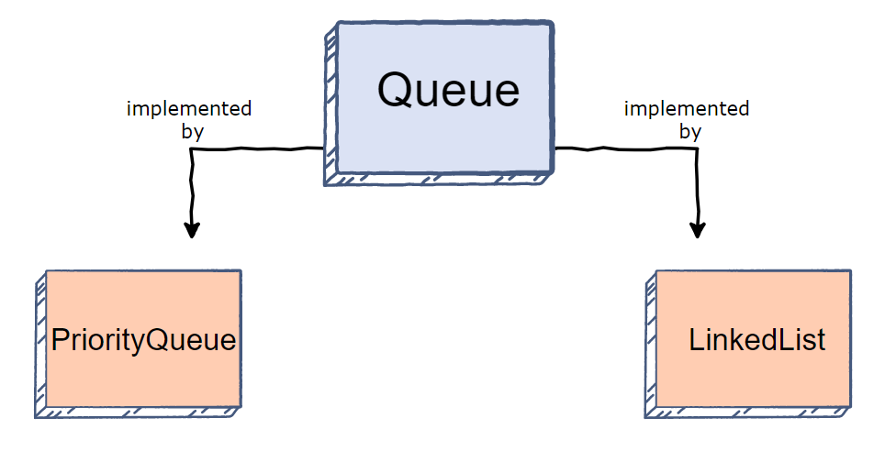
Qn2. New dating app
First come first serve: queue
Utilization of java.util.Queue API and java.util.LinkedList may be helpful in this problem.
Queue is an interface in java, so we should use LinkedList which implements queue here.
PriorityQueue will be covered in the following lectures.
Hints: create a Person class to record name and arrival time/waiting time of a male/female.
Notes:
Very simplified

Slide 17
Qn3. Uncle Grandpa and Big Calculator
Implement a simple calculation, with just one operation: non-negative integer addition.
The integer is up to 10 to the power of 1000.
Example:
Input (bigcal1.in) | Output (bigcal1.out)
6942214966785782193371498 4577886852159258368196616 | 11520101818945040561568114
Notes:
Very simplified

Slide 18
Java BigInteger
Java has a BigInteger class which is used for mathematical operation involving very big integer calculations that are outside the limit of all available primitive data types.
The problem can be solved conveniently with the help of BigInteger.
Notes:
First thing that popped into my mind when i read question

Slide 19
Java BigInteger
import java.util.*;
import java.math.BigInteger;
public class Bigcal {
private void run() {
Scanner in = new Scanner(System.in);
String raw_a = in.next();
String raw_b = in.next();
BigInteger a = new BigInteger(raw_a);
BigInteger b = new BigInteger(raw_b);
System.out.println(a.add(b));
}
public static void main(String[] args) {
Bigcal newBigcal = new Bigcal();
newBigcal.run();
}
}
Notes:
Always plan before jumping straight to coding

Slide 20
Java BigInteger
Java has a BigInteger class which is used for mathematical operation involving very big integer calculations that are outside the limit of all available primitive data types.
The problem can be solved conveniently with the help of BigInteger.
Unfortunately, for the purpose of learning, we cannot use the Java BigInteger
How can we solve the problem?
Notes:
First thing that popped into my mind when i read question

Slide 21
Basic idea
Use data structure stack/array to store two numbers digit by digit.
Add the two numbers digit by digit from the last digit.
For each addition, if the sum of the two digits exceeds 9, carry one to next digit.
Create a class called Bigcal.
In this class, “1234” will be represented by [4, 3, 2, 1]. This should make implementation easier.
Notes:
Java Api 11 is your best friend I dun care if you LL list = new LL<>();

Slide 22
Demonstration

Slide 23
Unix and Vim command

Slide 24
Thank you!

